Slide 1
INFO801 – Data Science Intro
Thomas Vuillaume, Frederic Gillardo, March 2021

Slide 2
Who am I
Thomas Vuillaume
Astrophysicist turned data scientist
Research engineer at LAPP (CNRS)
thomas.vuillaume [at] lapp.in2p3.fr / vuillaut.github.io
Working mainly on the Cherenkov Telescope Array

Slide 3


Slide 5
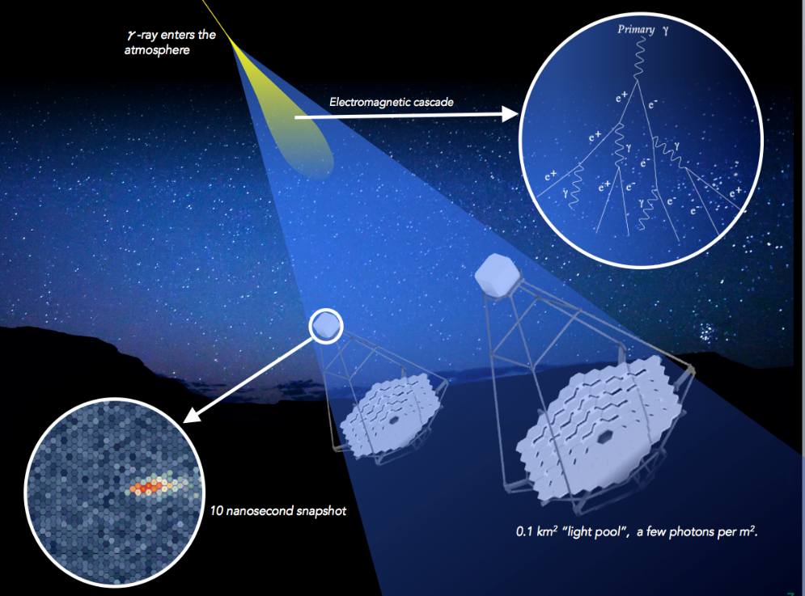
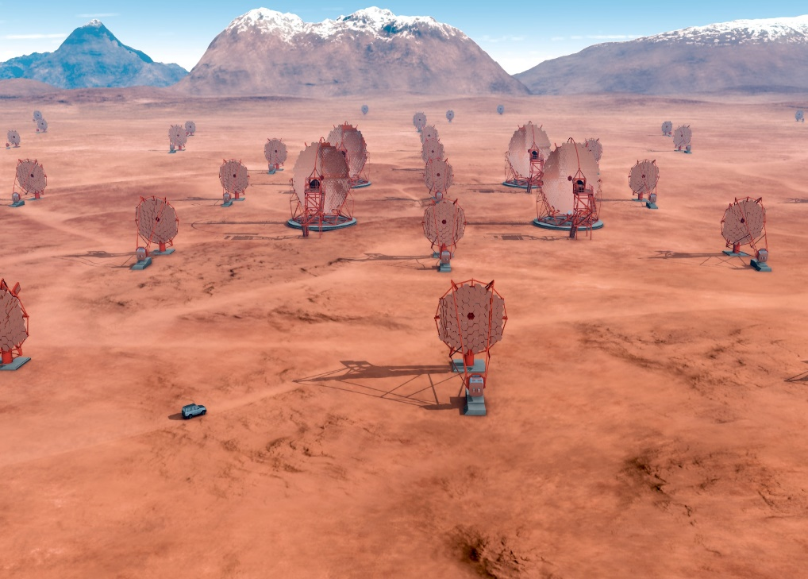
CTA?
The Cherenkov Telescope Array (CTA) is the next generation ground-based observatory for gamma-ray astronomy at very-high energies. With more than 100 telescopes located in the northern and southern hemispheres, CTA will be the world’s largest and most sensitive high-energy gamma-ray observatory. Supernova, neutron start , pulsar, black hole, black matter
The gamma rays that CTA will detect do not make it all the way to the Earth’s surface. When they reach the Earth’s atmosphere they interact with it, producing cascades of very-high energy particles in the atmosphere creating a cone of blue “Cherenkov light”.

Slide 6
Who are you?

Slide 7
What do you expect from this class?
Why did you register for this class?

Slide 8
Data Science

Slide 9
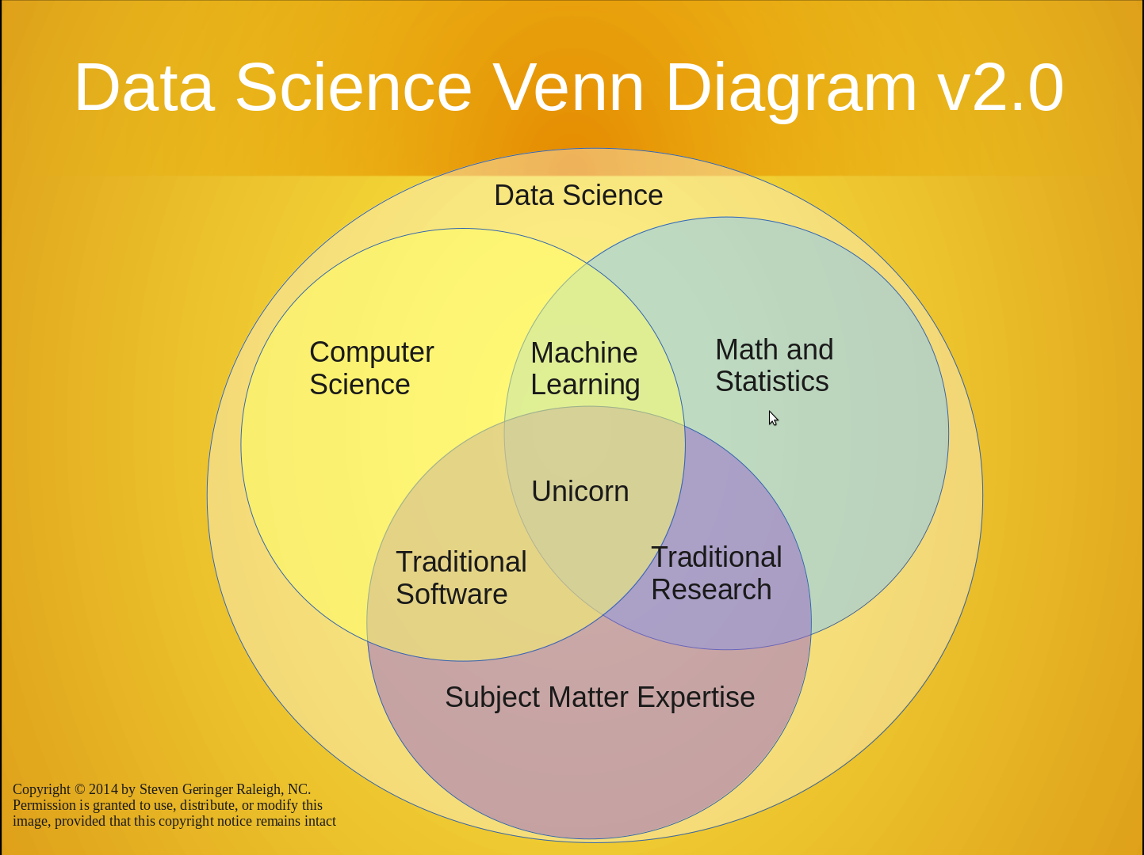
Science of analysing data
Mix of statistics and computer science
Became very important in many industries in the last years because of big data – quantity of data to analyse

Slide 10
Jargon
There is a lot of new jargon you haven’t heard before
Don’t be afraid to ask if you don’t understand
Reference: http://www.datascienceglossary.org/

Slide 11
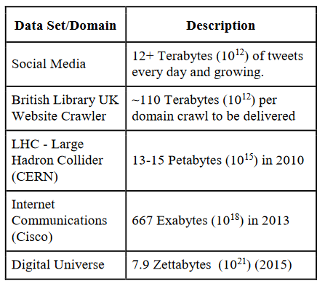
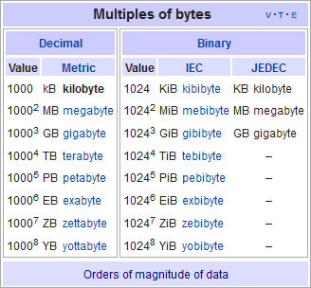
Introduction to Data Science
What is big data?
From wikipedia:
Big data usually includes data sets with sizes beyond the ability of commonly used software tools to capture, curate, manage, and process data within a tolerable elapsed time.^{[21]} Big data philosophy encompasses unstructured, semi-structured and structured data, however the main focus is on unstructured data.^{[22]} Big data "size" is a constantly moving target, as of 2012 ranging from a few dozen terabytes to many exabytes of data.
Big data represents the information assets characterized by such a high volume, velocity and variety to require specific technology and analytical methods for its transformation into value

Slide 12
Large scale use cases with lots of data
Google's search engine
Recommendations from Amazon and Netflix
Bank and Credit Card fraud detection
Logistics (DHL, UPS) of fleet management
Healthcare records from patients
Each depends on availability of compute and data
Notes:
https://www.thrillist.com/entertainment/nation/how-new-netflix-recommendation-algorithm-works#
https://medium.com/netflix-techblog/artwork-personalization-c589f074ad76
https://www.wired.co.uk/article/how-do-netflixs-algorithms-work-machine-learning-helps-to-predict-what-viewers-will-like

Slide 13
What is your use case?

Slide 14
Data Science Tools

Slide 15

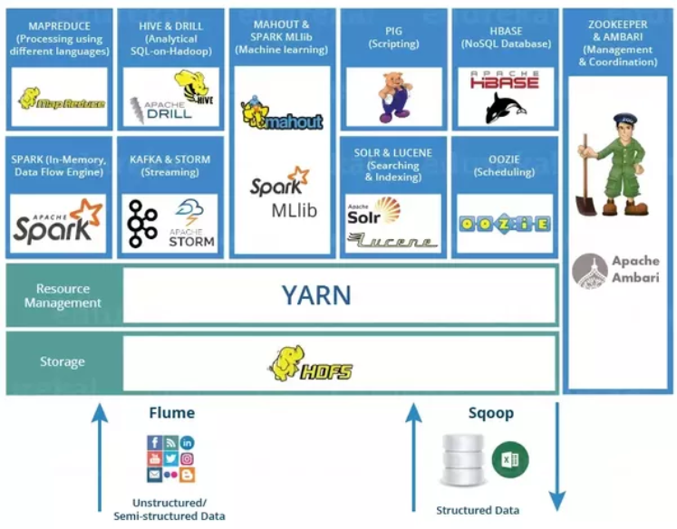




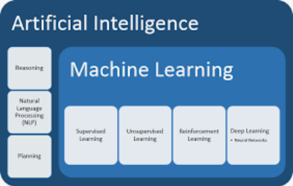

Slide 16
Python is the most popular language for data science

Slide 17
Python is the most popular language for data science
Raise your hand if you have heard of Python

Slide 18
Python is the most popular language for data science
Raise your hand if you have heard of Python
Raise your hand if you have used Python

Slide 19
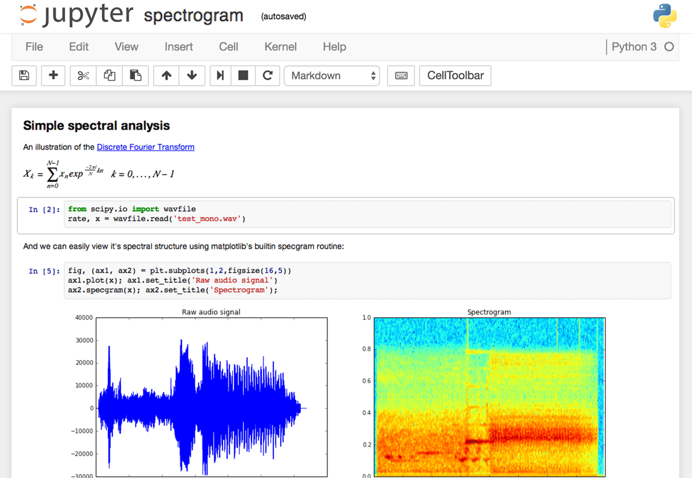
Raise your hand if you have used a Jupyter Notebook

Slide 20
Raise your hand if you have used a Jupyter Notebook
Good for:
Exploration of data
Exploration of algorithms, libraries
Document what you do
Visualize results

Slide 21
How to
Online: google colab, mybinder.org, deepnote.com
On a distant server, e.g. MUST
On your own laptop / computer
Install !
Conda environments

Slide 22


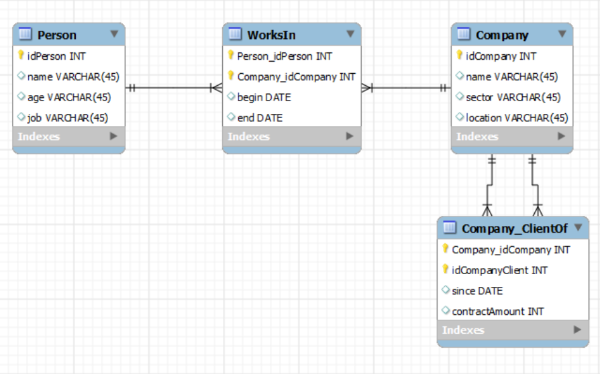
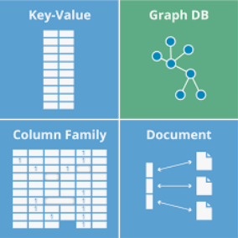

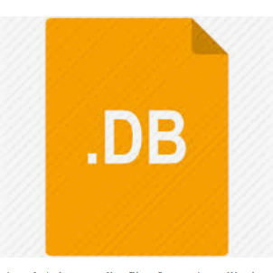
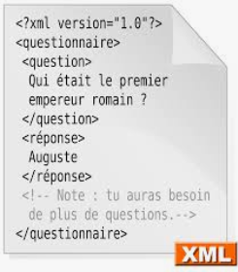
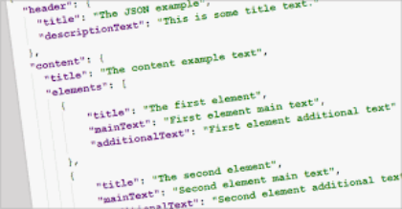
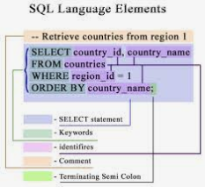
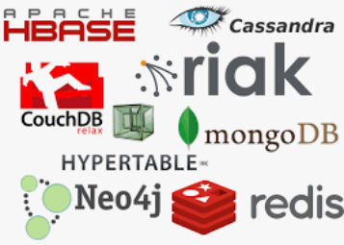
Acquiring Data
SQL DB
NOSQL DB
Files

Slide 23
Data formats
Examples of data formats. Structured vs unstructured.
CSV
Excel
JSON
XML
Unstructured text (i.e. txt)
Images (i.e. png, jpg, bmp, svg)
Sound (i.e. mp3, wav)
Images + sound: video
Plain text; how your data often is provided to you
Notes:
An outline of what I plan to cover in Data 601
https://www.loc.gov/preservation/resources/rfs/
https://www.loc.gov/preservation/resources/rfs/TOC.html
https://www.loc.gov/preservation/resources/rfs/stillimg.html#photodigital

Slide 24
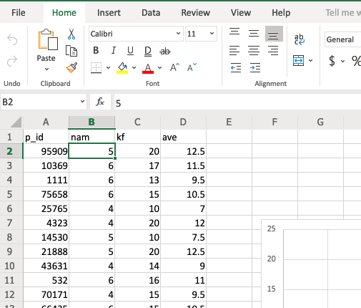
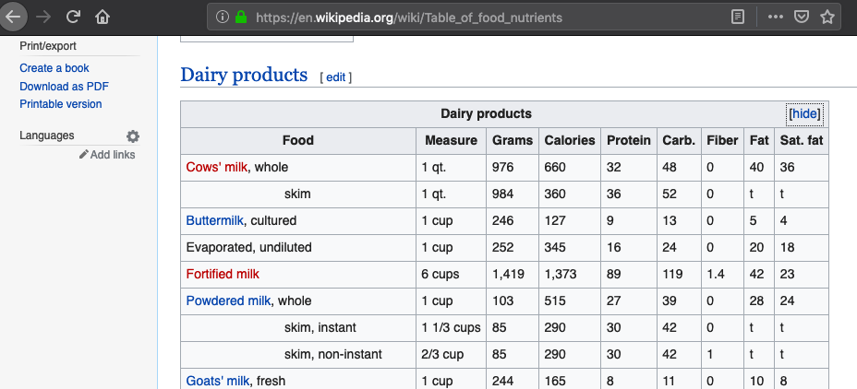
Data formats - tables
Notes:
An outline of what I plan to cover in Data 601
https://www.loc.gov/preservation/resources/rfs/
https://www.loc.gov/preservation/resources/rfs/TOC.html
https://www.loc.gov/preservation/resources/rfs/stillimg.html#photodigital

Slide 25

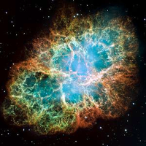
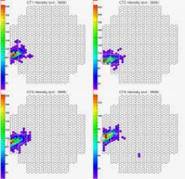
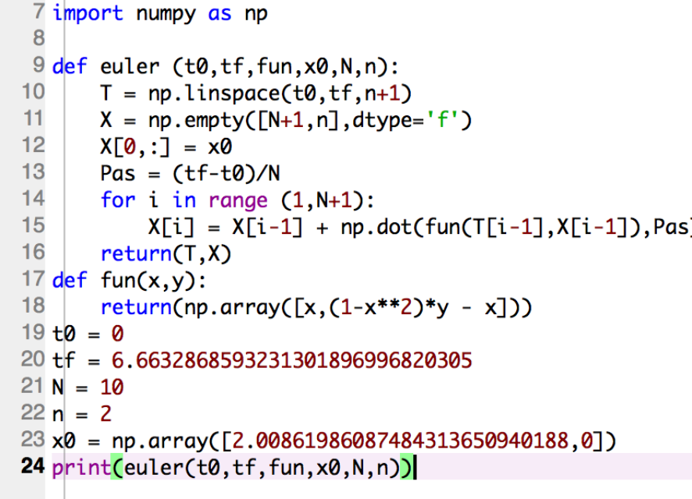
Data science process
Pattern recognition
Analysis
Insight/intuition

Slide 26
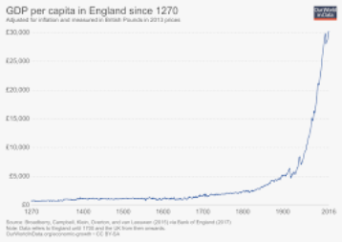
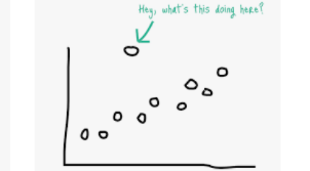
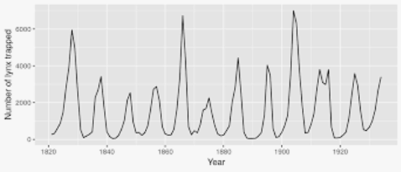
3. Data science steps 2. Exploring Data
General trends
Outliers

Slide 27
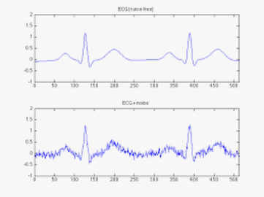
Preprocessing Data
Clean
Duplicate records
Missing values
Invalid data
Outliers
Transform
Scaling
Denoizing
Feature Selection
Combine
Remove
Notes:
Scaling : taille/ poid
Feature selection :
Post code / town
1 post code -> several town
Remove post code?
Dimensionnal
draw a graph in 3d :
age/ income/ level of education

Slide 28
Analyse Data
Clustering
In general, Clustering tries to group a set of objects and find whether there is some relationship between the objects.
Beer-diaper example
Classification
The goal is to predict the category of the input data. (binary or not) For example:
pregnant/ Not pregnant
handwritten digit
Regression
your model has to predict a numeric value instead of a category then the task becomes a regression problem.
classification/regression is supervised learning and clustering is unsupervised learning

Slide 29
Useful Links introduction
http://www.numpy.org/
https://www.kaggle.com/
https://github.com/vuillaut/info801
Notes:
conda env create -f environment.yml
Conda envs list
Conda activate
Jupyter notebook

